Slide 1
Ideas for the Observatory MVP: Before and after the launch at Ideas Lab

Slide 2
Before

Slide 3
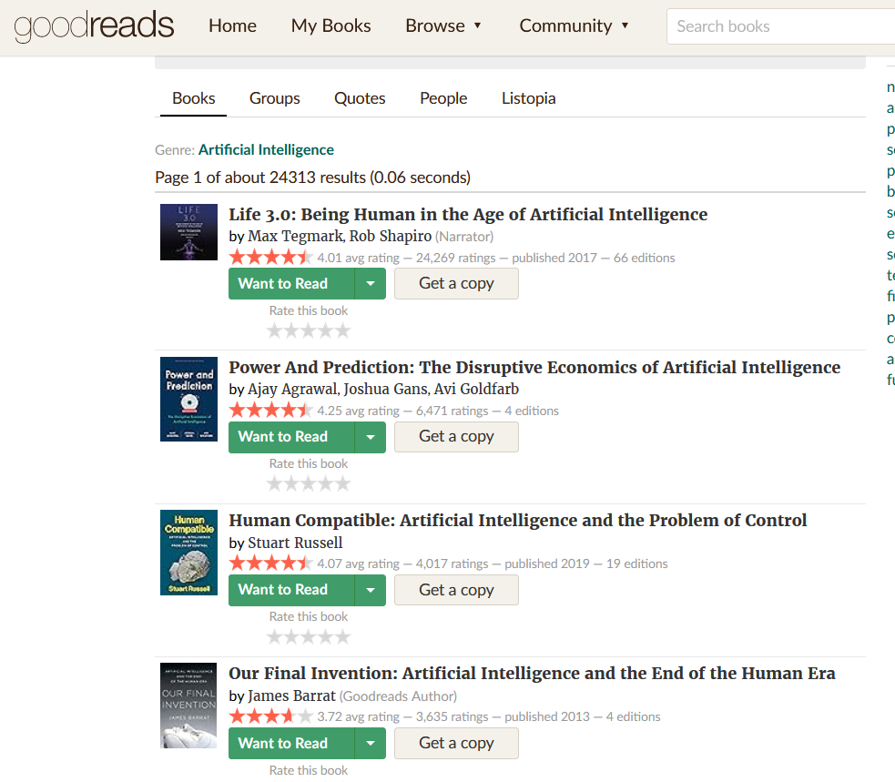
Book recommendations from experts like PA
1. "L'Intelligence Artificielle et la Nouvelle Société" by Yann Le Cun, Yoshua Bengio, and Hervé Le Crosnier - This book delves into the societal impacts of AI, exploring its potential to reshape industries and economies, likely touching on industrial policy aspects.
2. "La révolution de l'intelligence artificielle" by Stéphane Mallat - Mallat is a prominent figure in the French AI community, and this book might offer insights into both the technical and societal dimensions of AI, potentially with a nod to industrial policy implications.
3. "L'IA pour tous: Regards croisés sur l'intelligence artificielle" by Collectif - This book could provide a comprehensive overview of AI from various perspectives, including its implications for industrial policy in France and beyond.
4. "IA et Industrialisation: Quelles Perspectives pour l'Industrie Française?" by Jean-Pierre Corniou and Henri Isaac - Focusing specifically on the intersection of AI and industrialization, this book likely offers valuable insights into how AI is shaping the future of French industries and the associated policy considerations.
5. "Les défis de l'intelligence artificielle: L'Europe face à la nouvelle révolution industrielle" by Cedric Villani - Given Villani's expertise in mathematics and his involvement in AI policy discussions in France, this book could provide a deep dive into the challenges and opportunities posed by AI for European industries, potentially with a focus on French industrial policy strategies.

Slide 4
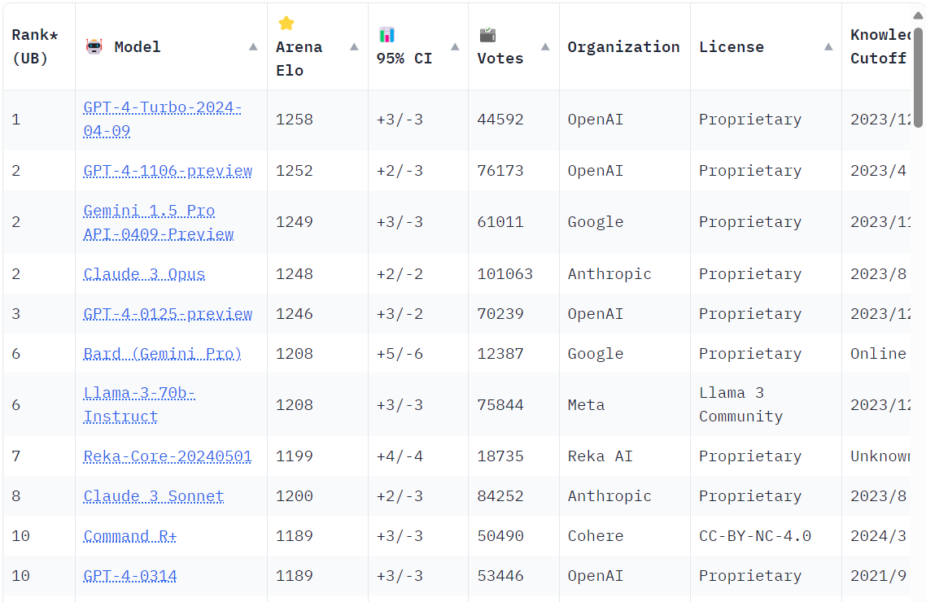
Rankings for single indicators
Notes:
Chatbot Arena

Slide 5
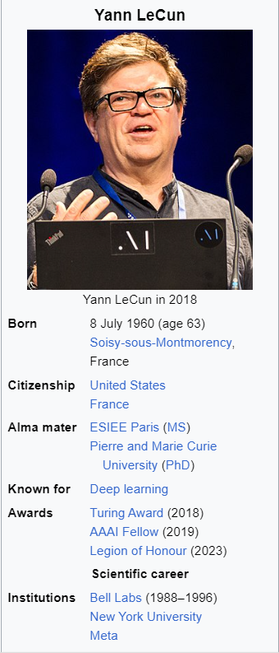
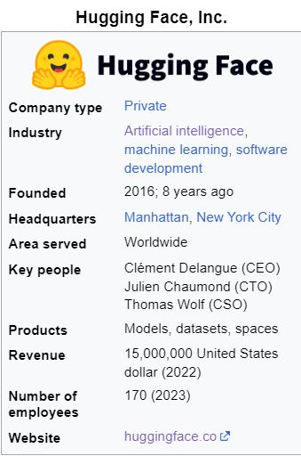
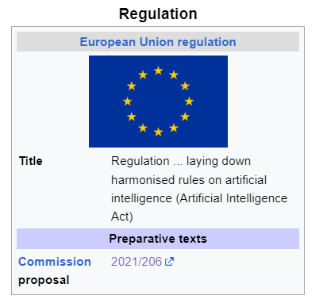
Manually-created top profiles

Slide 6
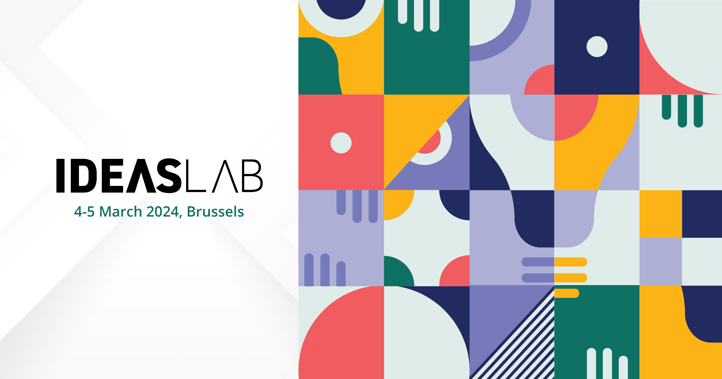
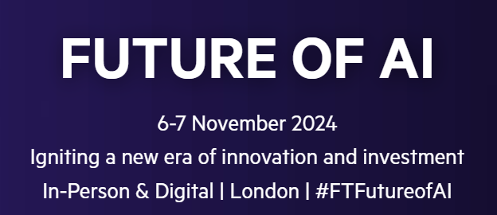
Event Top Pics

Slide 7
After

Slide 8
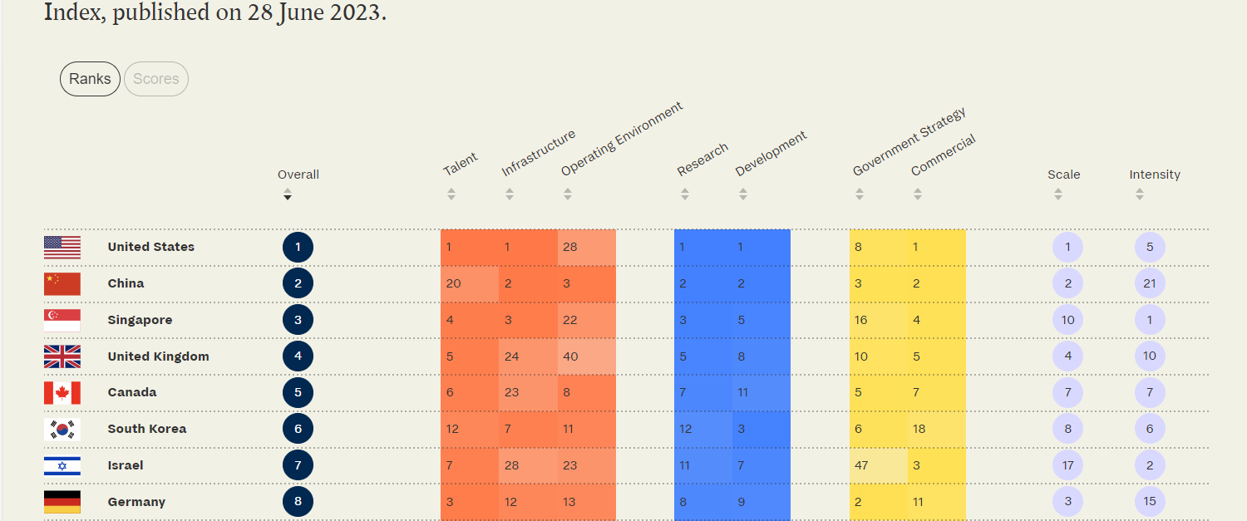
Multi-variable AI index
Notes:
Tortoise Media

Slide 9
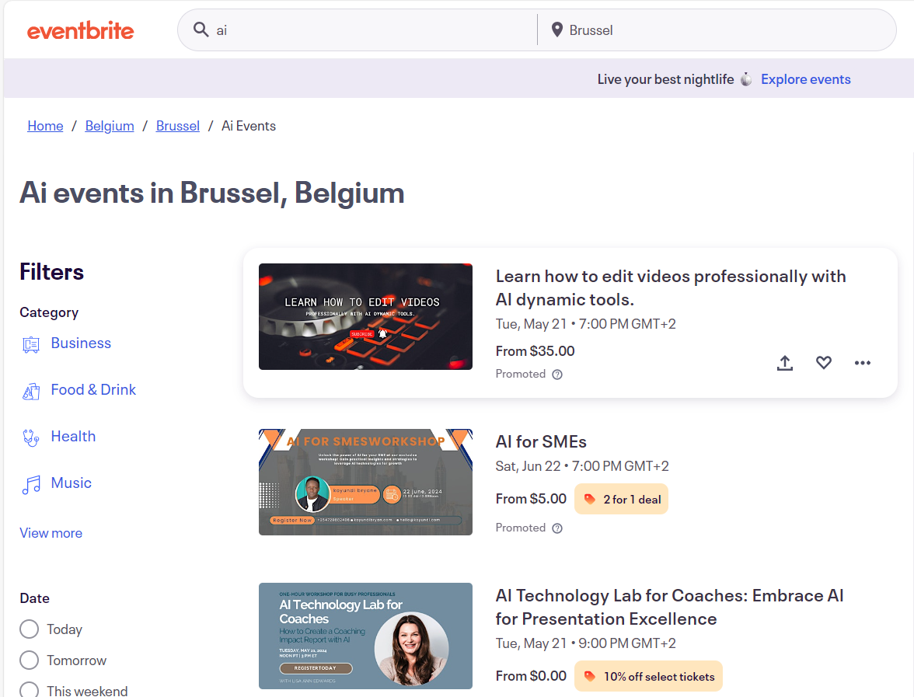
Best AI events per location

Slide 10
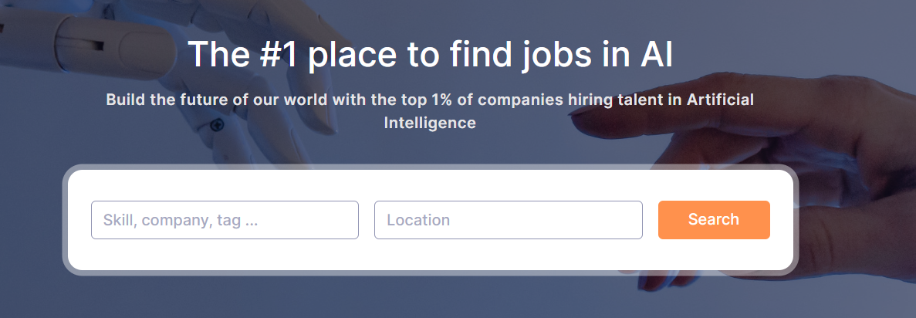
AI job board

